Slide 1
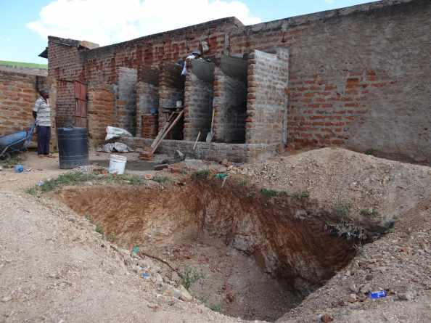
UBSUP
Construction of toilets and septic tanks

Slide 2
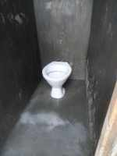
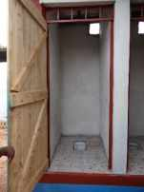
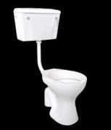
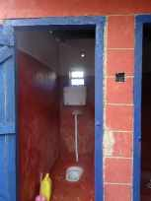
THE TOILETS
Options
Pour Flush sitting type
Pour Flush squatting type
Cistern Flush sitting type
Cistern Flush squatting type

Slide 3
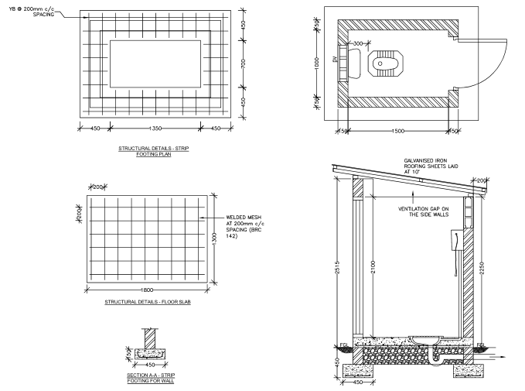
THE TOILETS
Technical Specifications
Ensure dimensions are respected
Ensure proper reinforcement

Slide 4
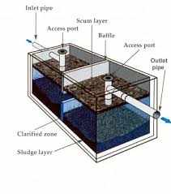
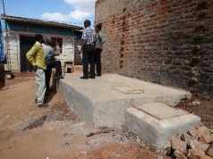
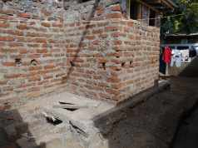
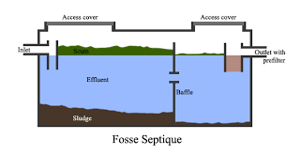
THE SEPTIC TANKS
Principle
2 consecutive chambers separated with a baffle wall. Separation of solid (sludge at the bottom) and liquid (foam on top). Liquid part goes from chamber 1 to chamber 2 to a soak away pit.
Only accumulated sludge need to be emptied
Less emptying than any holding/conservancy tank → cost saving on exhauster services
Septic tank build besides the toilets
Septic tank build under the toilets (if space is lacking)

Slide 5
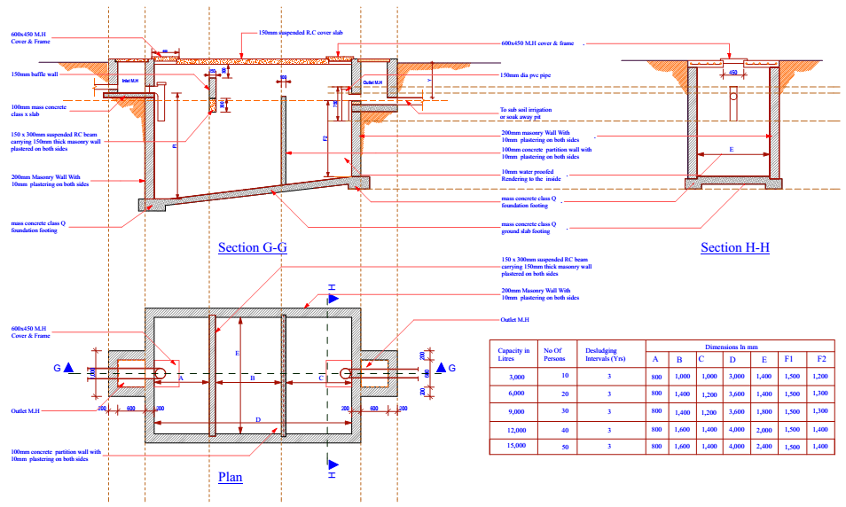
THE SEPTIC TANKS
Technical specifications

